Slide 1

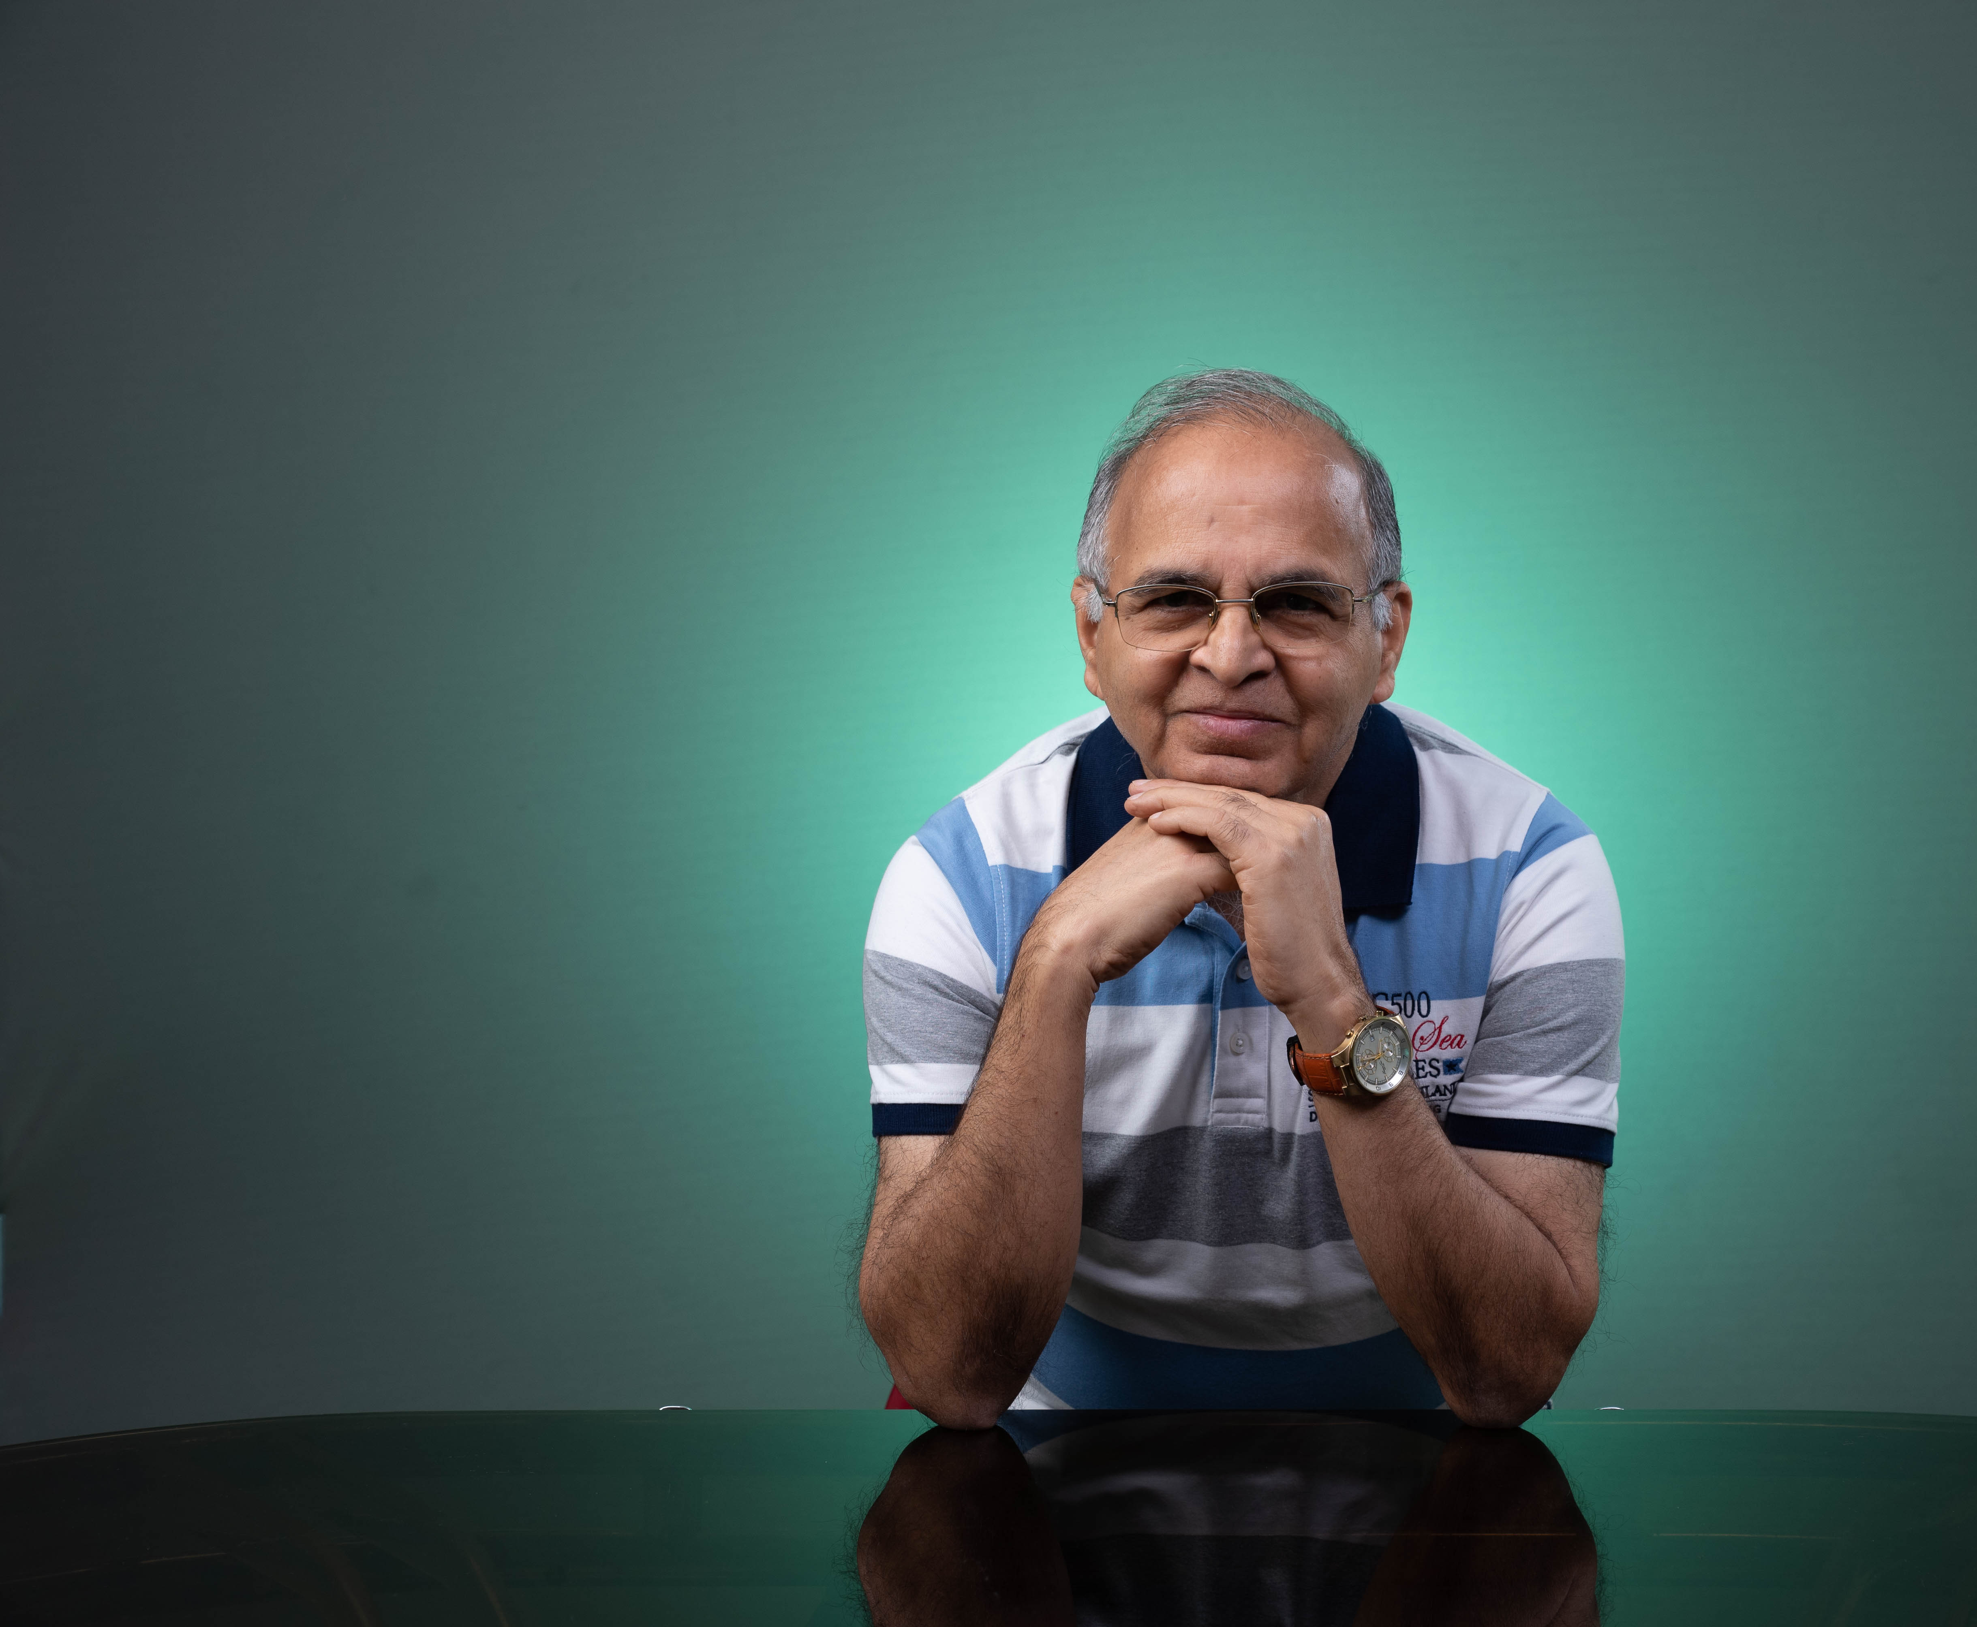
Effective Mind Power Academy
Do you always want to be happy no matter what?
Do you want to live stress free life?
Are you caught between Work-Life balance?
If answer to these questions is ‘Yes’ then this course is for you. This course is for Professionals, Leaders, Executives, Managers and business persons -- practically everybody.
Personal Mastery
Through
Happiness,
Success,
And
Work-Life Balance

Slide 2
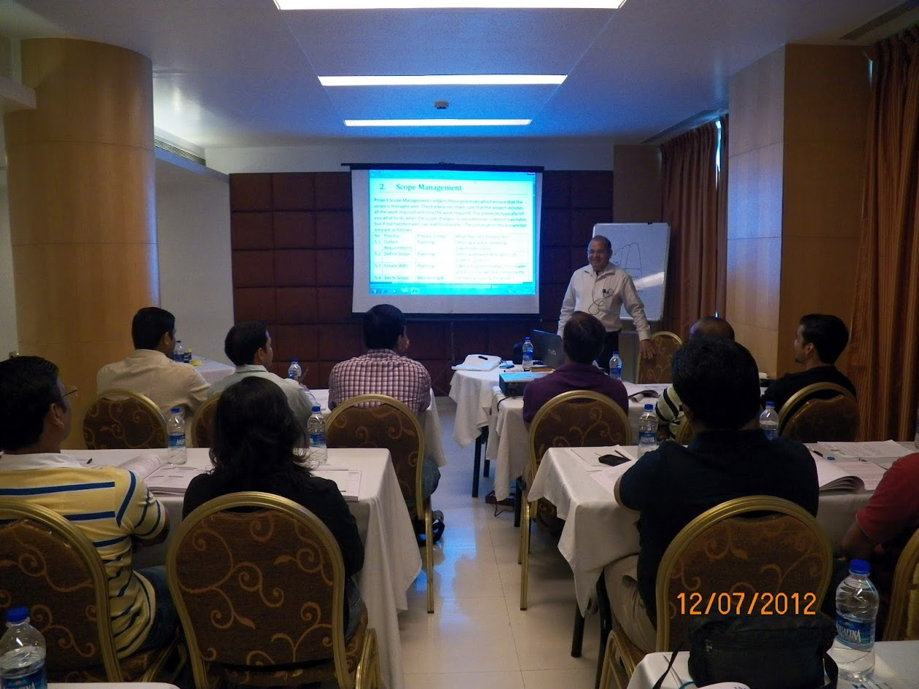
About Your Coach
Sateesh Kamat – 68 years
B. Tech. From IIT Kharagpur ( 1974)
DMS From University of Mumbai ( 1979)
PMP , PMI-ACP,CSM,CSPO Certified Professional
Knowledge, Experience and Wisdom gathered over 46 years
Machine and structural Design – 24 years
Software SAP-ERP Implementation – 11 years
Project Management Training for PMP® and PMI-ACP® Certifications of PMI®-USA --11 years
Lead Happy Life
I felt a strong urge to do something for today’s busy, stressed and torn between work and life executive. Therefore I decided to start www.leadhappylife.com . Yes, Lead Happy Life no matter what.

Slide 3
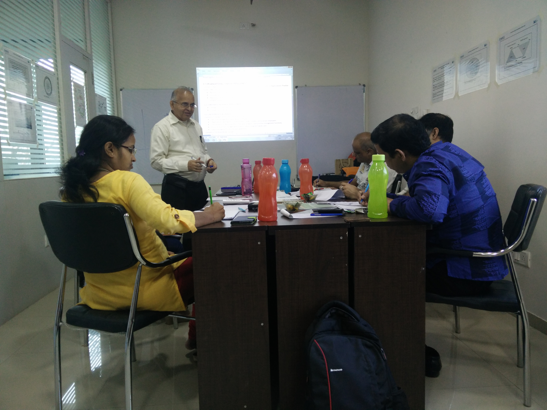
What do you take away
Personal Mastery is about having the right mental attitude to make decisions and take actions in your life. It is about exploring the best in yourself, in others and the world around you.
Certificate of Participation from Effective Project Management Consultancy.
This will be a PMI® approved course for 16 Professional Development Units. It will also be useful for maintaining Certifications like PMP®, PgMP® and PMI-ACP®.
Printed Notes with Practice Workbook with examples and tools.
You define your goal/roadmap to set your direction, measure the results and set new goals with your coach, Sateesh Kamat.
Personal Mentoring for 6 months from Sateesh Kamat. We put you on the path and you walk towards your goal. You assess your success.

Slide 4
Contact us today
Effective Mind Power Academy ,
808,Solus,Hiranandani Estate
Thane (w) 400607
www.leadhappylife.com
www.effectivepma.com
Phones
Aditi Posam : 7718833017
Sateesh Kamat :9769885111,902905111
Vaijayantee Kamat: 9769803111
Email: aditi@effectivepma.com
sateesh@effectivepma.com
vaijayantee@effectivepma.com

